Slide 1
Network-Aware Recommendation Engine for Enhanced Streaming Performance
NETFLIX
Name: Mounika Vangali
Course: ICT - 4902 Capstone Seminar
Professor: Donald Halloran

Slide 2

Problem Statement
Traditional recommendation engines focus only on user preferences, ignoring network conditions.
This leads to buffering, quality drops, and poor user experience.
02

Slide 3
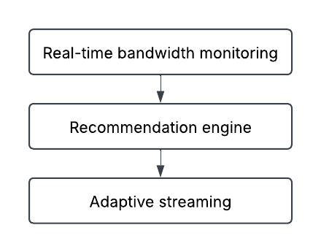
Approach
Our Strategy
Monitor network speed in real-time.
Adjust content recommendations based on available bandwidth.
Leverage AI-driven caching and ML optimization for seamless streaming.
03

Slide 4



Our Mission And Vision
Our Mission
To enhance streaming by adjusting recommendations based on real-time network conditions for seamless, high-quality playback.
Our Vision
To create an intelligent, adaptive streaming experience that minimizes buffering and ensures optimal video quality on any device.
04

Slide 5
Solution
Detect Network Speed
Analyze User Preferences
Recommend Content Accordingly
Real-time Bandwidth Monitoring → Checks available speed.
Adaptive Recommendation Engine → Suggests videos optimized for network conditions.
AI-Driven Caching & Compression → Reduces load without losing quality.
05

Slide 6

Discussion
Performance Evaluated Using:
Buffering Time Reduction
Resolution Stability
User Engagement
06

Slide 7
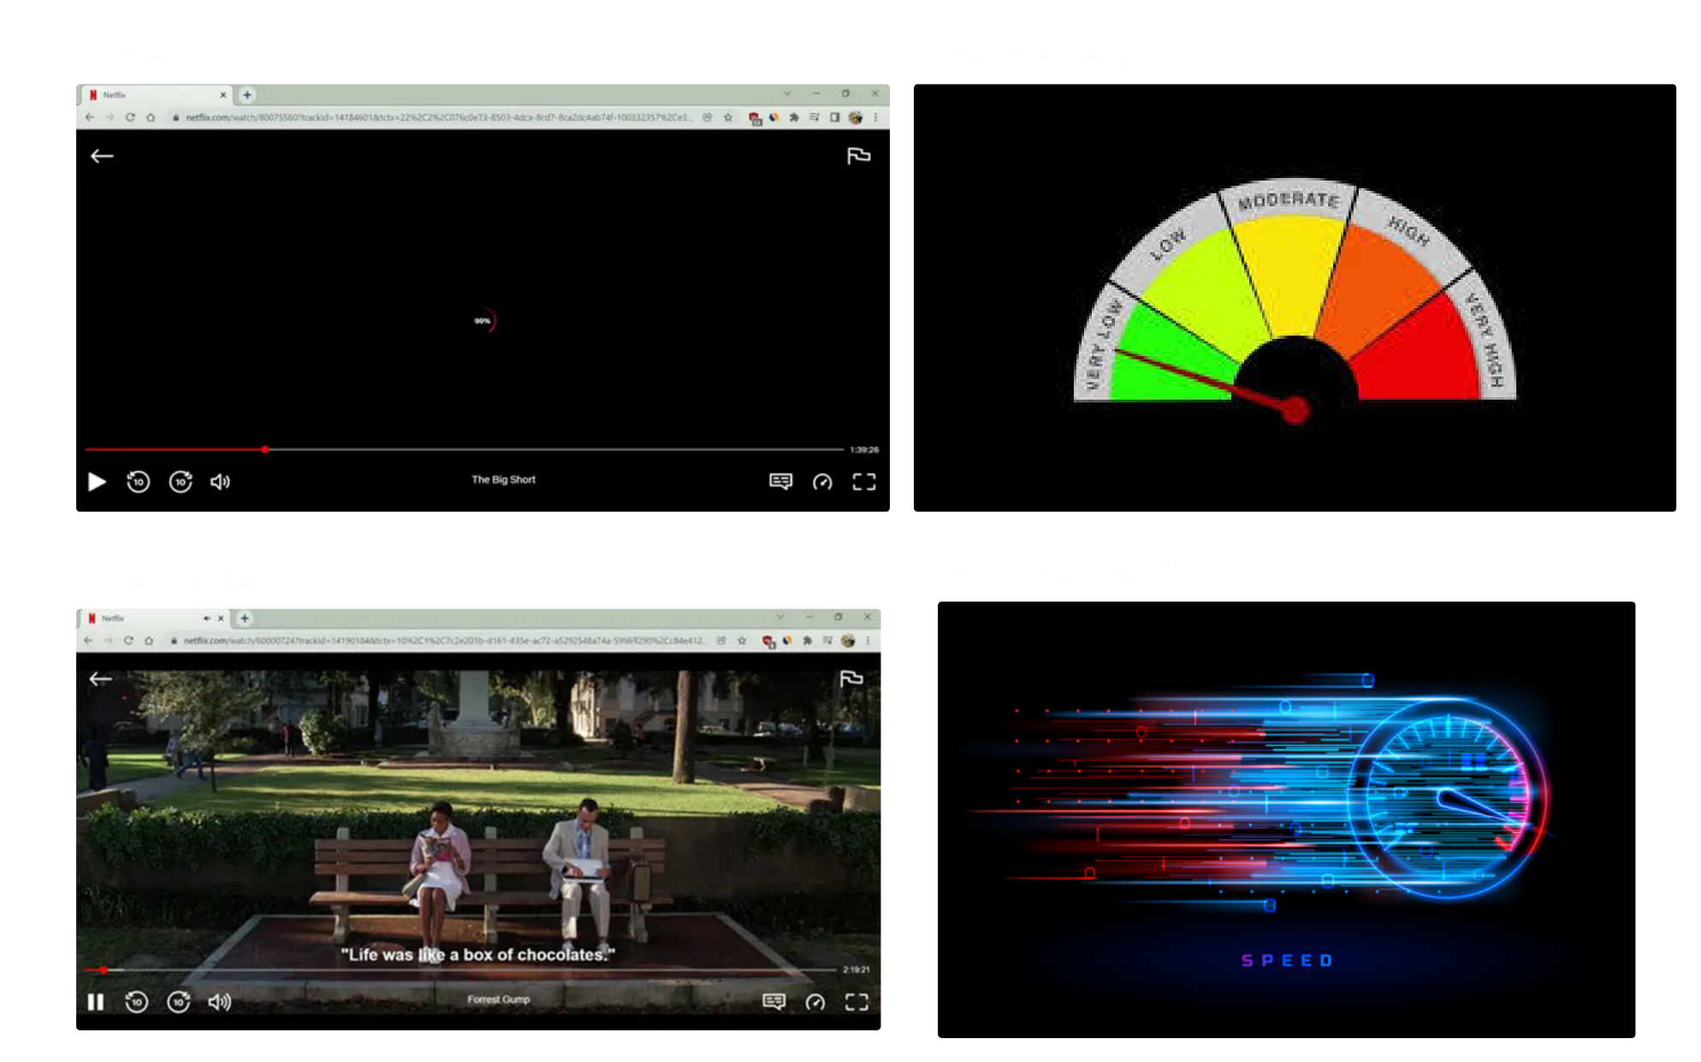
07

Slide 8

Recommendations
Expanding the Model
Predictive AI Analytics
Integration with Live Streaming
Multi-Device Optimization
08

Slide 9
Advantages
Disadvantages
Improved User Experience
Dynamic Content Delivery
Reduced Bandwidth Usage
Better User Retention
Scalable Solution
Edge Server Integration
Increased Complexity
Dependency on Network Infrastructure
Possible Delays in Recommendations
Data Privacy Concerns
Hardware and Bandwidth Limitations
Increased Server Load
09

Slide 10

Conclusion
Network-aware recommendations enhance streaming performance.
AI and real-time data can reduce buffering and improve QoE.
Future innovations will push streaming to the next level.
10

Slide 11
THANK YOU
ANY QUESTIONS ?
11

